Slide 1
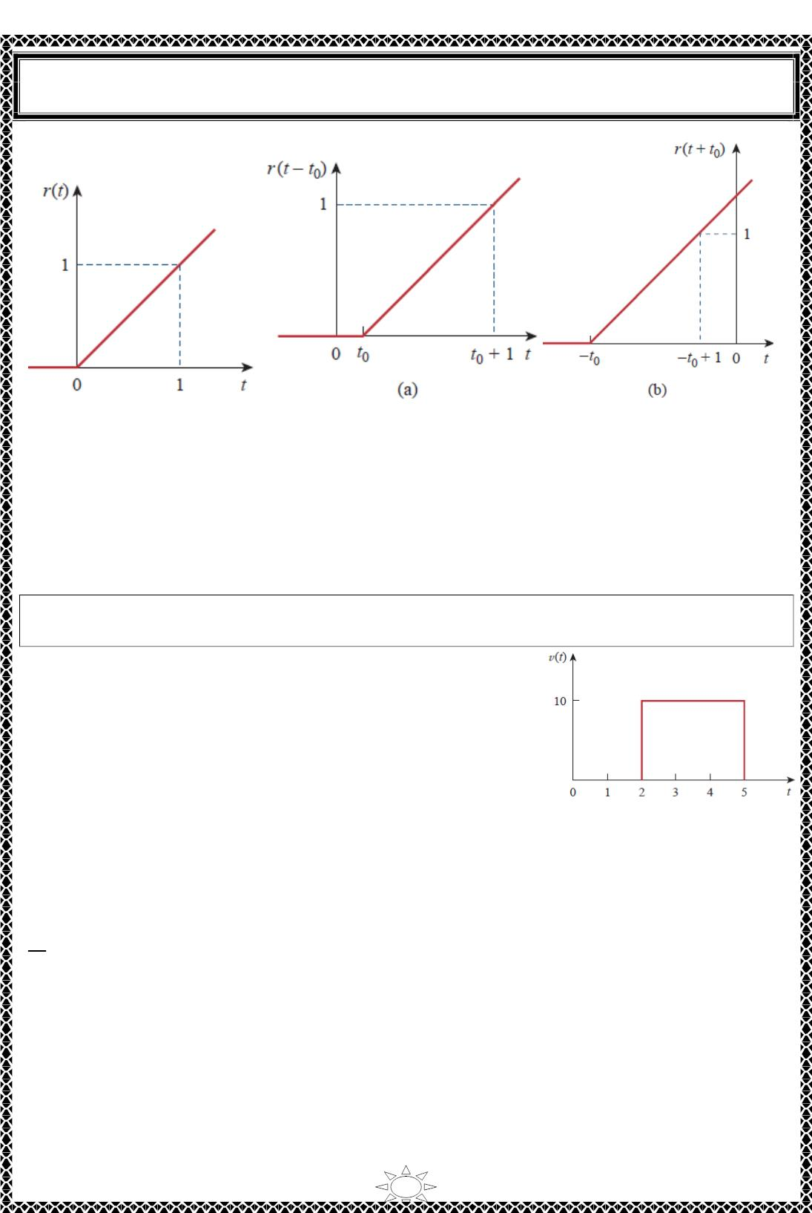
University of Diyala
Engineering College
Electrical Circuits
Fig.4.7 The unit ramp function.
Fig.4.8 The unit ramp function
(a) delayed by t (b) advanced by t .
0
0
Trail Version
Trail Version
Trail Version
Trail Version
Trail Version
Trail Version
Trail Version
Trail Version
Trail Version
Trail Version
Trail Version
Trail Version
Trail Version
Example 6: Express the voltage pulse in Fig.1 in terms of the unit step. Calculate its
derivative and sketch it.
Solution: The type of pulse in Fig.1 is called the gate
function. It may be regarded as a step function that switches
on at one value of 푡 and switches off at another value of 푡.
This gate function switches on at 푡 = 2푠 and switches off at
푡 = 5푠. It consists of the sum of two unit step functions as
shown in Fig.2 (a). From the figure, it is evident that
푣(푡) = 10푢(푡 − 2) − 10푢(푡 − 5) = 10[푢(푡 − 2) − 푢(푡 − 5)]
Taking the derivative of this gives
Fig.1
푑ꢀ
= 10[훿(푡 − 2) − 훿(푡 − 5)]
푑ꢁ
which is shown in Fig.2 (b). We can obtain Fig.2 (b). directly from Fig.1. by simply
observing that there is a sudden increase by 10 푉 at 푡 = 2푠 leading to 10훿(푡 − 2) . At 푡 =
5푠, there is a sudden decrease by 10 푉 leading to −10푉 훿(푡 − 5) .
18

Slide 2
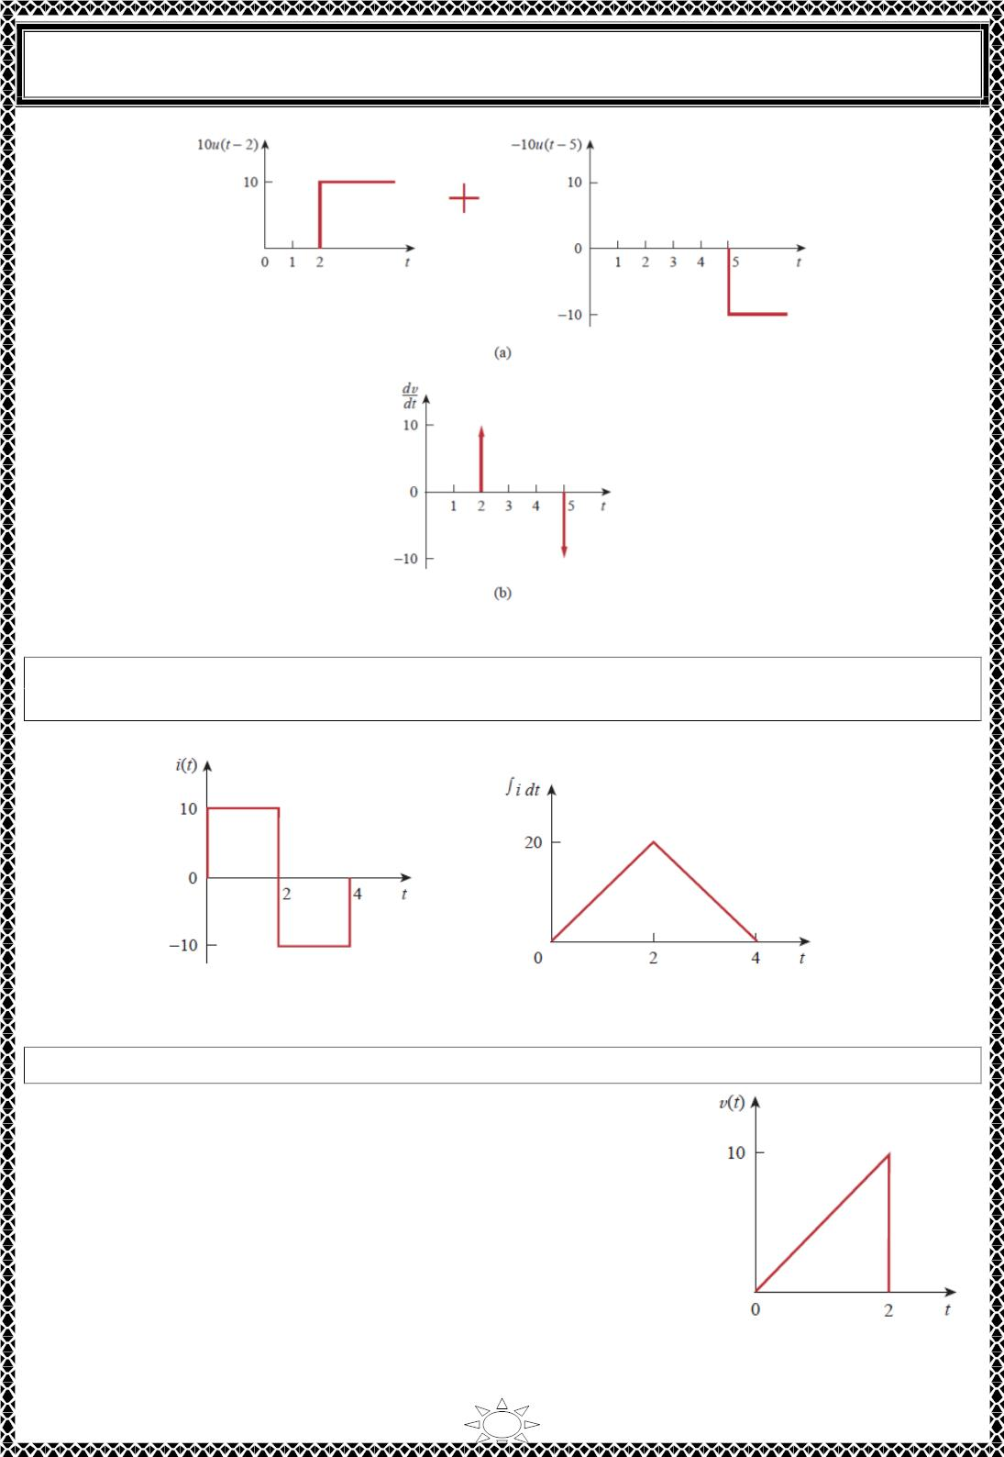
University of Diyala
Engineering College
Electrical Circuits
Fig.2 (a) Decomposition of the pulse in Fig.1, (b) derivative of the pulse in Fig.1.
Trail Version
Trail Version
Trail Version
Trail Version
Trail Version
Trail Version
Trail Version
Trail Version
Trail Version
Trail Version
Trail Version
Trail Version
Trail Version
H.W. 6: Express the current pulse in Fig.1in terms of the unit step. Find its integral and
sketch it.
Answer:10[푢(푡) − 2푢(푡 − 2) + 푢(푡 − 4)], 10[푟(푡) − 2푟(푡 − 2) + 푟(푡 − 4)]. See Fig.2.
Fig.1
Fig.2
Example 7: Express the sawtooth function shown in Fig.1in terms of singularity functions.
Solution:
There are three ways of solving this problem. The first method
is by mere observation of the given function, while the other
methods involve some graphical manipulations of the function.
Fig.1
19

Slide 3
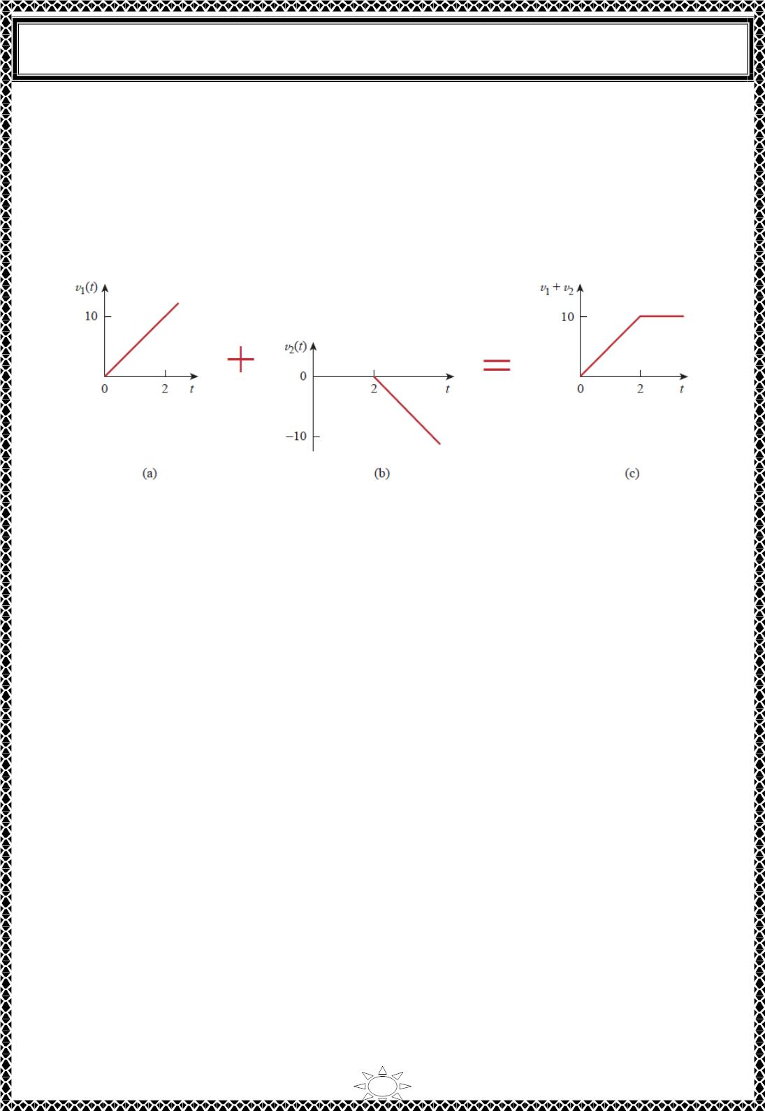
University of Diyala
Engineering College
Electrical Circuits
METHOD 1 By looking at the sketch of 푣(푡) in Fig.1, it is not hard to notice that the
given function 푣(푡) is a combination of singularity functions. So we let
푣(푡) = 푣 (푡) + 푣 (푡) + ⋯
(1)
1
2
The function 푣₁(푡) is the ramp function of slope 5, shown in Fig.2 (a); that is,
푣₁(푡) = 5푟(푡)
(2)
Trail Version
Trail Version
Trail Version
Trail Version
Trail Version
Trail Version
Trail Version
Trail Version
Trail Version
Trail Version
Trail Version
Trail Version
Trail Version
Fig.2 Partial decomposition of 푣(푡) in Fig.1.
Since 푣(푡) goes to infinity, we need another function at 푡 = ꢀ푠 in order to get 푣(푡) . We
let this function be 푣₂, which is a ramp function of slope −5, as shown in Fig.2 (b); that is,
푣₂(푡) = −5푟(푡 − ꢀ)
Adding 푣 and 푣 gives us the signal in Fig.2 (c). Obviously, this is not the same as 푣(푡)
(3)
1
2
in Fig.1. But the difference is simply a constant 10 units for 푡 > ꢀ푠. By adding a third
signal 푣₃, where
푣₃ = −ꢁ0푢(푡 − ꢀ)
(4)
we get 푣(푡) , as shown in Fig.3. Substituting Eqs. (2) through (4) into Eq. (1) gives
푣(푡) = 5푟(푡) − 5푟(푡 − ꢀ) − ꢁ0푢(푡 − ꢀ)
20

Slide 4
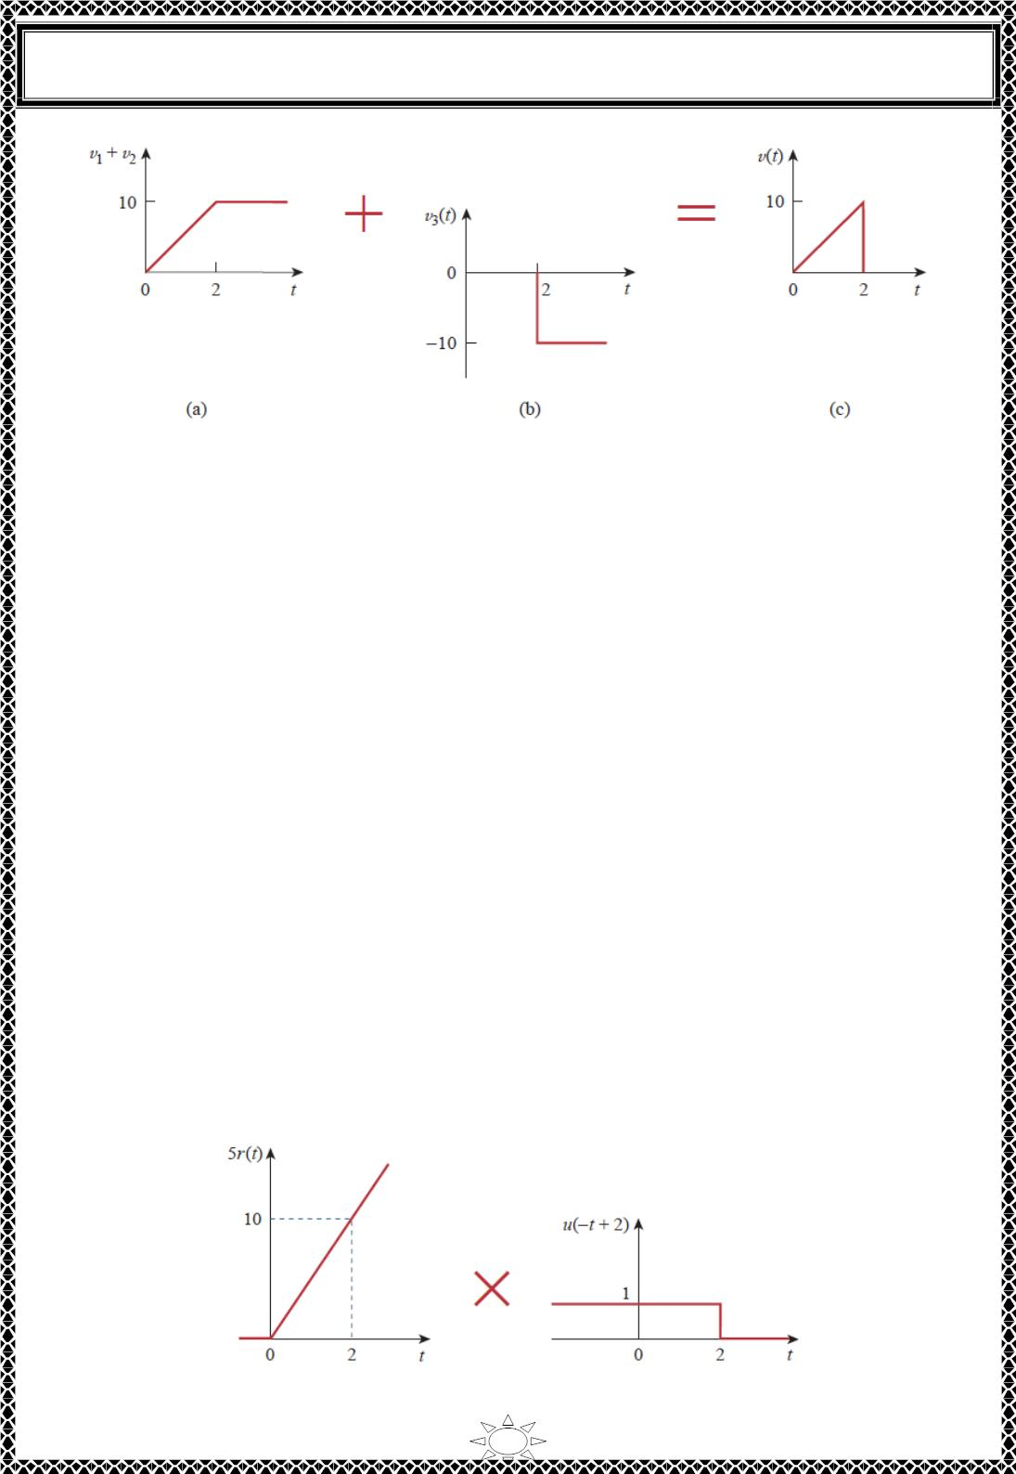
University of Diyala
Engineering College
Electrical Circuits
Fig.3 Complete decomposition of 푣(푡) in Fig.1.
METHOD 2 A close observation of Fig.1 reveals that 푣(푡) is a multiplication of two
functions: a ramp function and a gate function. Thus,
푣(푡) = 5푡[푢(푡) − 푢(푡 − 2)] = 5푡푢(푡) − 5푡푢(푡 − 2)
= 5푟(푡) − 5(푡 − 2 + 2)푢(푡 − 2) = 5푟(푡) − 5(푡 − 2)푢(푡 − 2) − 10푢(푡 − 2)
= 5푟(푡) − 5푟(푡 − 2) − 10푢(푡 − 2)
Trail Version
Trail Version
Trail Version
Trail Version
Trail Version
Trail Version
Trail Version
Trail Version
Trail Version
Trail Version
Trail Version
Trail Version
Trail Version
the same as before.
METHOD 3 This method is similar to Method 2. We observe from Fig.1 that 푣(푡) is a
multiplication of a ramp function and a unit step function, as shown in Fig.4. Thus,
푣(푡) = 5푟(푡)푢(−푡 + 2)
If we replace 푢(−푡) by 1 − 푢(푡) , then we can replace 푢(−푡 + 2) by 1 − 푢(푡 − 2) .
Hence,
푣(푡) = 5푟(푡)[1 − 푢(푡 − 2)]
which can be simplified as in Method 2 to get the same result.
Fig.4. Decomposition of v(t) in Fig.1.
21

Slide 5
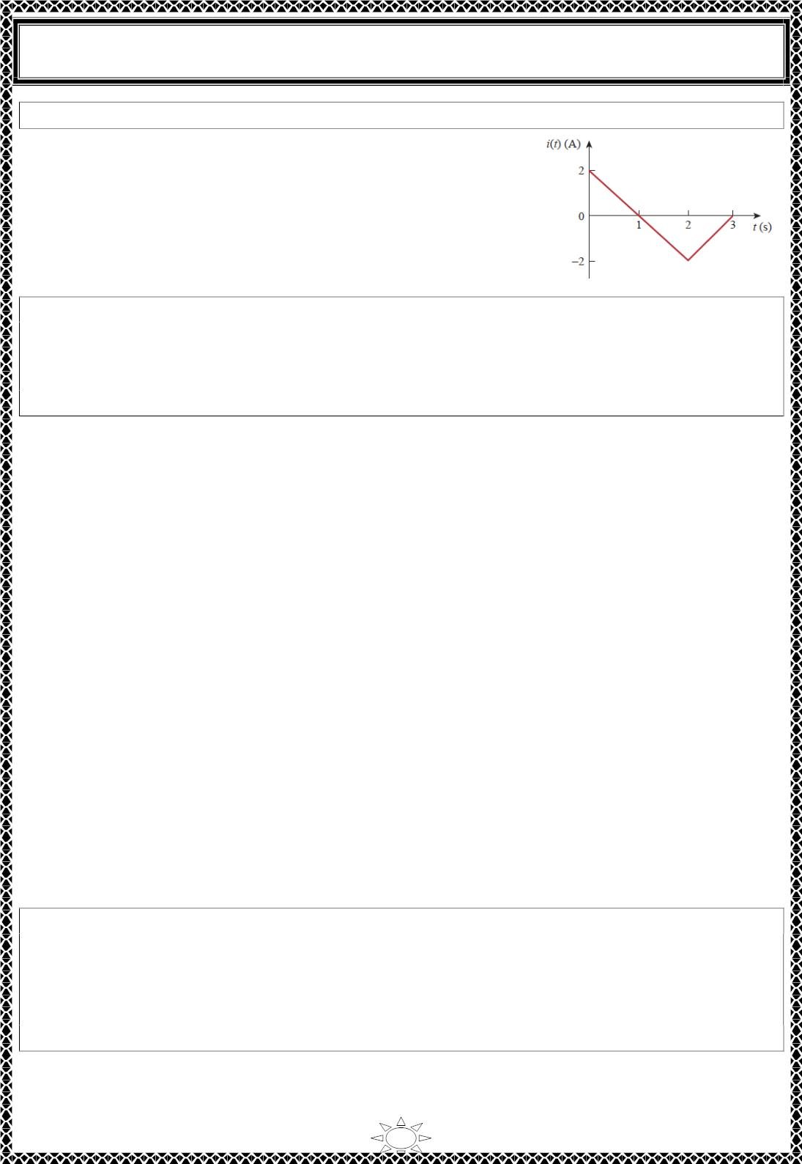
University of Diyala
Engineering College
Electrical Circuits
H.W. 7: Refer to Fig.1. Express ꢀ(푡) in terms of singularity functions.
Answer: ퟐ풖(풕) − ퟐ풓(풕) + ퟒ풓(풕 − ퟐ) − ퟐ풓(풕 − ퟑ) .
Fig.1
Example 8: Given the signal
3,
푡 < 0
0 < 푡 < 1
푡 > 1
푔(푡) = {−2,
2푡 − 4,
express 푔(푡) in terms of step and ramp functions.
Solution:
The signal 푔(푡) may be regarded as the sum of three functions specified within the three
intervals 푡 < 0, 0 < 푡 < 1, and 푡 > 1.
Trail Version
Trail Version
Trail Version
Trail Version
Trail Version
Trail Version
Trail Version
Trail Version
Trail Version
Trail Version
Trail Version
Trail Version
Trail Version
For 푡 < 0, 푔(푡) may be regarded as 3 multiplied by 푢(−푡) , where 푢(−푡) = 1 for 푡 < 0
and 0 for 푡 > 0. Within the time interval 0 < 푡 < 1, the function may be considered as −2
multiplied by a gated function [푢(푡) − 푢(푡 − 1)]. For 푡 > 1, the function may be regarded
as 2푡 − 4 multiplied by the unit step function 푢(푡 − 1) . Thus,
푔(푡) = 3푢(−푡) − 2[푢(푡) − 푢(푡 − 1)] + (2푡 − 4)푢(푡 − 1)
= 3푢(−푡) − 2푢(푡) + (2푡 − 4 + 2)푢(푡 − 1)
= 3푢(−푡) − 2푢(푡) + 2(푡 − 1)푢(푡 − 1) = 3푢(−푡) − 2푢(푡) + 2푟(푡 − 1)
One may avoid the trouble of using 푢(−푡) by replacing it with 1 − 푢(푡) . Then
푔(푡) = 3[1 − 푢(푡)] − 2푢(푡) + 2푟(푡 − 1) = 3 − 5푢(푡) + 2푟(푡 − 1)
Alternatively, we may plot 푔(푡) and apply Method 1 from Example 7.
H.W. 8: If
0,
8,
푡 < 0
0 < 푡 < 2
ℎ(푡) = ꢁ
2푡 + 6, 2 < 푡 < 6
0, 푡 > 6
express ℎ(푡) in terms of the singularity functions.
Answer: ퟖ풖(풕) + ퟐ풖(풕 − ퟐ) + ퟐ풓(풕 − ퟐ) − ퟏퟖ풖(풕 − ퟔ) − ퟐ풓(풕 − ퟔ) .
22

Slide 6

University of Diyala
Engineering College
Electrical Circuits
Example 9: Evaluate the following integrals involving the impulse function:
10
∫ ( 푡² + 4푡 − ꢀ)훿(푡 − ꢀ)푑푡
∞
0
∫ [ 훿(푡 − ꢂ)푒^{ꢁꢃ} cos 푡 + 훿(푡 + ꢂ)푒^{ꢁꢃ} sin 푡]푑푡
Solution:
ꢁ∞
For the first integral, we apply the sifting property in Eq. (4.9).
10
² + 4푡 − ꢀ)훿(푡 − ꢀ)푑푡 = (푡² + 4푡 − ꢀ)|ꢃꢅ2 = 4 + 8 − ꢀ = ꢂꢆ
ꢄ ( 푡
0
Similarly, for the second integral,
∞
∫ [ 훿(푡 − ꢂ)푒^{ꢁꢃ} cos 푡 + 훿(푡 + ꢂ)푒^{ꢁꢃ} sin 푡]푑푡
ꢁ∞
= 푒^{ꢁꢃ} cos 푡|_{ꢃꢅ1} + 푒^{ꢁꢃ} sin 푡|_{ꢃꢅꢁ1} = 푒^{ꢁ1} cos ꢂ + 푒¹ sin (−ꢂ) = ꢆ.ꢂ988 − ꢀ.ꢀ873 = −ꢀ.ꢆ885
Trail Version
Trail Version
Trail Version
Trail Version
Trail Version
Trail Version
Trail Version
Trail Version
Trail Version
Trail Version
Trail Version
Trail Version
Trail Version
H.W. 9: Evaluate the following integrals:
∞
10
∫ ( 푡^{ꢇ} + 5푡² + ꢂꢆ)훿(푡 + 3)푑푡,
∫ 훿 (푡 − 휋) cos 3푡푑푡
ꢁ∞
0
Answer: 28, −ퟏ.
23

Slide 7
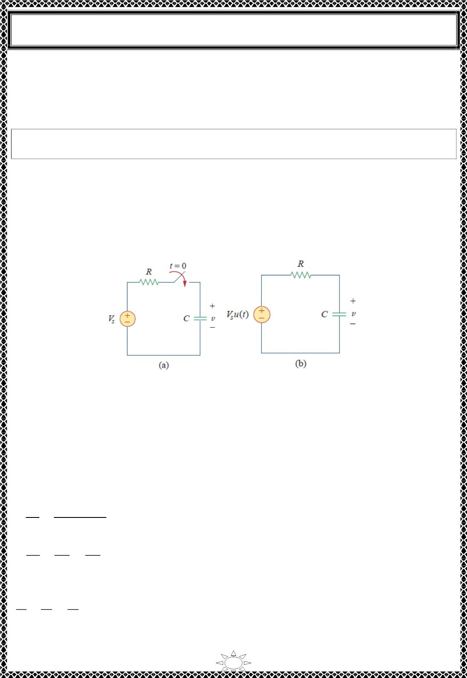
University of Diyala
Engineering College
Electrical Circuits
5) Step Response of an 푹푪 Circuit
When the dc source of an 푅퐶 circuit is suddenly applied, the voltage or current source can
be modeled as a step function, and the response is known as a step response.
The step response of a circuit is its behavior when the excitation is the step
function, which may be a voltage or a current source.
The step response is the response of the circuit due to a sudden application of a dc voltage
or current source.
Consider the 푅퐶 circuit in Fig.5.1 (a) which can be replaced by the circuit in Fig.5.1 (b),
where 푉 is a constant dc voltage source. We assume an initial voltage 푉 on the capacitor,
푠
0
although this is not necessary for the step response.
Trail Version
Trail Version
Trail Version
Trail Version
Trail Version
Trail Version
Trail Version
Trail Version
Trail Version
Trail Version
Trail Version
Trail Version
Trail Version
Fig.5.1 An RC circuit with voltage step input.
Since the voltage of a capacitor cannot change instantaneously,
푣(ꢀ−) = 푣(ꢀ+) = 푉
where 푣(ꢀ is the voltage across the capacitor just before switching and
(5.1)
−)
0
푣(ꢀ+)
is its
voltage immediately after switching. Applying KCL, we have
푑푣 푣 ꢂ 푉 푢(푡)
퐶
∴
ꢁ
푠
= ꢀ
푑푡
푅
푑푣
푣
푉
푠
ꢁ
=
푢(푡)
(5.2)
(5.3)
푑푡 푅퐶 푅퐶
where 푣 is the voltage across the capacitor. For 푡 > ꢀ, Eq. (5.2) becomes
ꢃꢄ
ꢃꢅ
ꢄ
ꢈ
ꢉ
ꢆꢇ
ꢁ
=
ꢆꢇ
Rearranging terms gives
24

Slide 8

University of Diyala
Engineering College
Electrical Circuits
푑푣
푑푡
= −
푣 − 푉
푠
푅퐶
∴
푑푣
= −
푑푡
(5.4)
푣 − 푉
푅퐶
푠
Integrating both sides and introducing the initial conditions,
ꢁ(ꢂ)
푡
ꢂ
푙푛 (푣 − 푉_{푠})|ꢀ = −
|
ꢃ
0
푅퐶
ꢂ
ln (푣(푡) − 푉 ) − 푙푛(푉 − 푉 ) = − + ꢆ
푠
ꢃ
푠
ꢄꢅ
ꢁꢇꢀ
ꢂ
푙푛
ꢈ
= −
(5.5)
ꢀ ꢇꢀ
ꢄꢅ
0
ꢈ
Taking the exponential of both sides
푣 − 푉
푠
= 푒^{ꢇꢂ/휏}, ꢉ = 푅퐶
푉_{ꢃ} − 푉
푠
Trail Version
Trail Version
Trail Version
Trail Version
Trail Version
Trail Version
Trail Version
Trail Version
Trail Version
Trail Version
Trail Version
Trail Version
Trail Version
푣 − 푉 = (푉 − 푉 )푒^{ꢇꢂ/휏}
푠
ꢃ
푠
ꢊ
ꢋ
ꢇ
(5.6)
(5.7)
∴ 푣(푡) = 푉 + (푉 − 푉 )푒 , 푡 > ꢆ
Thus,
푠
ꢃ
푠
푉 ,
푡 < ꢆ
ꢃ
푣(푡) = {
푉 + (푉 − 푉 )푒^{ꢇꢂ/휏}, 푡 > ꢆ
푠
ꢃ
푠
This is known as the complete response (or total response) of the 푅퐶 circuit to a sudden
application of a dc voltage source, assuming the capacitor is initially charged. The reason
for the term “complete” will become evident a little later. Assuming that 푉 > 푉 , a plot of
푠
ꢃ
푣(푡) is shown in Fig.5.2.
If we assume that the capacitor is uncharged initially, we set 푉_{ꢃ} = ꢆ in Eq. (5.7) so that
ꢆ, 푡 < ꢆ
푣(푡) = {
푉_{푠}(1 − 푒^{ꢇꢂ/휏}) , 푡 > ꢆ
(5.8)
which can be written alternatively as
푣(푡) = 푉 (1 − 푒^{ꢇꢂ/휏})푢(푡)
(5.9)
푠
This is the complete step response of the 푅퐶 circuit when the capacitor is initially
ꢅꢍꢁ
uncharged. The current through the capacitor is obtained from Eq. (5.8) using ꢌ(푡) =
ꢍꢂ
.
We get
25

Slide 9
Trail Version
Trail Version
Trail Version
Trail Version
Trail Version
Trail Version
Trail Version
Trail Version
Trail Version
Trail Version
Trail Version
Trail Version
Trail Version

Slide 10

University of Diyala
Engineering College
Electrical Circuits
We are familiar with the natural response 푣_{푛} of the circuit, as discussed response, (b)
current response. in Section 2. 푣_{푓} is known as the forced response because it is produced by
the circuit when an external “force” (a voltage source in this case) is applied. It represents
what the circuit is forced to do by the input excitation. The natural response eventually
dies out along with the transient component of the forced response, leaving only the
steady‐ state component of the forced response.
Another way of looking at the complete response is to break into two components—one
temporary and the other permanent, i.e.,
or
푣 = 푣_{푡} − 푣_{푠푠}
(5.12)
Trail Version
Trail Version
Trail Version
Trail Version
Trail Version
Trail Version
Trail Version
Trail Version
Trail Version
Trail Version
Trail Version
Trail Version
Trail Version
ꢀ푡/휏
where 푣 = (푉 − 푉 )푒
and 푣 = 푉
푠푠 푠
푡
표
푠
The transient response 푣_{푡} is temporary; it is the portion of the complete response that decays
to zero as time approaches infinity. Thus,
The transient response is the circuit’s temporary response that will die out with
time.
The steady‐state response 푣_{푠푠} is the portion of the complete response that remains after the
transient reponse has died out. Thus,
The steady-state response is the behavior of the circuit a long time after an
external excitation is applied.
The first decomposition of the complete response is in terms of the source of the
responses, while the second decomposition is in terms of the permanency of the responses.
Under certain conditions, the natural response and transient response are the same. The
same can be said about the forced response and steady‐state response.
Whichever way we look at it, the complete response in Eq. (5.6) may be written as
푣(ꢁ) = 푣(∞) + [푣(푂) − 푣(∞)]푒^{ꢀ푡/휏}
where 푣(푂) is the initial voltage at ꢁ = 0^{ꢂ} and
(5.13)
is the final or steady state value.
푣(∞)
‐
Thus, to find the step response of an 푅퐶 circuit requires three things:
1. The initial capacitor voltage 푣(푂) .
27

